Slide 1



Flow proposal for 14 days delivery SLA
14 Days
6 Days
1 Day
7 Days
SALES ORDER
PROCUREMENT PROCES
DELIVERY to CUSTOMERS
Pesanan Barang dari Customer (Farmers, Est. Owner or KUD)
Proses Pembelian barang oleh Purchasing
Proses Pengiriman barang ke Customer
Procurement Issue:
Lengthy Procurement Approval Process
Multilayer approval Bottleneck
Delivery Issue:
Delayed Fulfillment to Customer

Slide 2
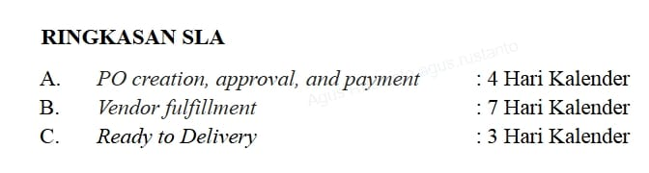
Ringkasan SLA
PO creation, approval, and payment : 4 Hari Kalender
Vendor fulfillment : 7 Hari Kalender
Ready to Delivery : 3 Hari Kalender

